Slide 1
DAX Architecture & Entity Sets
MUKESH KUMAR

Slide 2
AGENDA
What is DAX?
DAX Architecture (Formula Engine & Storage Engine)
How DAX Queries Work
Entity Sets in the Data Model
Relationship between Tables (Entities)

Slide 3
What is DAX?
DAX (Data Analysis Expressions) is a formula language used in:
Power BI
Excel Power Pivot
SSAS Tabular
Enables powerful data analysis and business logic creation.
Think of it like Excel formulas for relational data.

Slide 4
DAX Engine Architecture
DAX runs on xVelocity (VertiPaq) engine for in-memory processing.
Two main components:
Formula Engine (FE):
Parses and resolves the expression.
Works row-by-row for scalar values.
Slower but flexible.
Storage Engine (SE):
Retrieves data from memory (or disk in DirectQuery).
Highly optimized, very fast.
FE calls SE to fetch data during complex evaluations.
Tip: Optimizing DAX means minimizing FE calls and maximizing SE work.

Slide 5
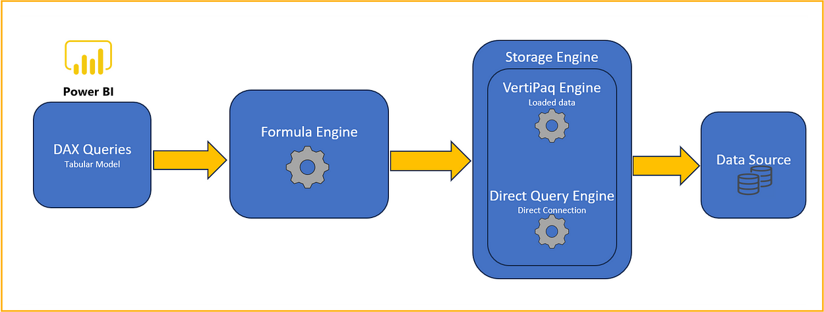

Slide 6
How DAX query is executed
Step 1: You Write a DAX Formula
Example: Total Sales = SUM(Sales[Amount])
Step 2: Formula Engine (FE) Takes Over
Reads the formula
Understands what needs to be calculated
Prepares the instructions
Think of FE as the "brain" – it plans what to do

Slide 7
How DAX query is executed
Step 3: FE Calls the Storage Engine (SE)
FE asks SE:
"Hey, give me all the values from Sales[Amount]"
SE fetches data from memory (VertiPaq) or from database (SQL in DirectQuery)
SE is the "muscle" – it fetches the data fast
Step 4: FE Uses the Data to Finish the Calculation
FE adds up the values from SE
Applies filters, conditions, or logic
Returns the final result

Slide 8
What are Entity Sets?
Entities = Tables in your data model.
Each table is a set of rows, i.e., entities of the same type.
Examples:
Customers (Customer entities)
Products (Product entities)
Think of each table as a database “object” or “entity.”

Slide 9
Relationships Between Tables
Entity sets are connected using relationships:
One-to-Many (Most common)
Many-to-One
Many-to-Many (requires special handling)
Relationships are used automatically by DAX during evaluation.

